Slide 1
Leveraging the Business Data Catalog
Surfacing backend data in SharePoint Server sites

Slide 2
Agenda
Motivation for the BDC
Application Definition Files
Application, Entities, Methods and Associations
Using the built-in BDC Web Parts
BDC integration with MOSS search
Creating custom BDC Web Parts

Slide 3
Design Motivations
Reduce the need for custom front-end code
Reuse SOA investments already in place
Create manageable method for reusing data
Centralized deployment
Centralized data security
Low latency
Designed for portal & collaboration scenarios
Data query, indexing, personalization
The BDC is not about: transactions, workflow, data transformation, adapters, precomposition

Slide 4
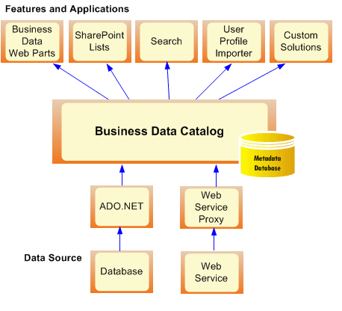
BDC Architecture

Slide 5
Application Definition Files
<?xml version="1.0" encoding="utf-8" standalone="yes"?>
<LobSystem xmlns:xsi="http://www.w3.org/2001/XMLSchema-instance"
xsi:schemaLocation="http://schemas.microsoft.com/office/sps/2005/bdcMetadata BDCMetadata.xsd"
Type="Database" Version="1.0.0.0" Name="AdventureWorksSample"
xmlns="http://schemas.microsoft.com/office/sps/2005/bdcMetadata">
<LobSystemInstances>
<LobSystemInstance Name="AdventureWorksSample">
<Properties>
<Property Name="AuthenticationMode" Type="System.String">PassThrough</Property>
<Property Name="DatabaseAccessProvider" Type="System.String">SqlServer</Property>
</Properties>
</LobSystemInstance>
</LobSystemInstances>
<Entities>
<Entity EstimatedInstanceCount="10000" Name="Product"/>
<Entity EstimatedInstanceCount="10000" Name="SalesOrder"/>
<Entity EstimatedInstanceCount="10000" Name="Customer"/>
</Entities>
<Associations>
<Association AssociationMethodEntityName="Customer"
AssociationMethodName="GetSalesOrdersForCustomer"
AssociationMethodReturnParameterName="SalesOrders"
Name="CustomerToSalesOrder" IsCached="true">
<SourceEntity Name="Customer" />
<DestinationEntity Name="SalesOrder" />
</Association>
</Associations>
</LobSystem>
Notes:
Instructor Notes
This slide shows an example of how BDC metadata is defined inside an XML file. If you have time to do a demonstration, you should consider showing students how to upload a predefined XML file with BDC metadata to create a new application.
Next, show them how to surface BDC data use the Business Data Web Parts such as the Business Data List Web Part. If you want to do one more thing, show students how to configure a BDC application as a content source and then demonstrate how MOSS search can find results from a BDC data source.

Slide 6
Tools for Building Definitions
BDC Meta Man
http://www.bdcmetaman.com/
Free version for SQL Server data sources
Licensed version adds Web service, Oracle, ODBC
Action builder
Visual designer
Multiple entity support
Configuration of LOBSystems, LOBSystemInstances, Entities, Methods, etc.
Simego MOSS BDC Design Studio
http://www.simego.com/#MOSS
Various efforts on CodePlex, GotDotNet
Some SDK-delivered functionality is in the works

Slide 7
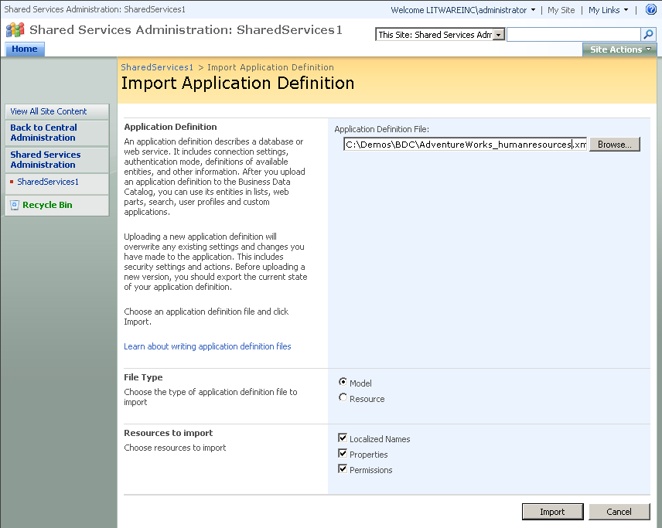
Importing Application Definition Files

Slide 8
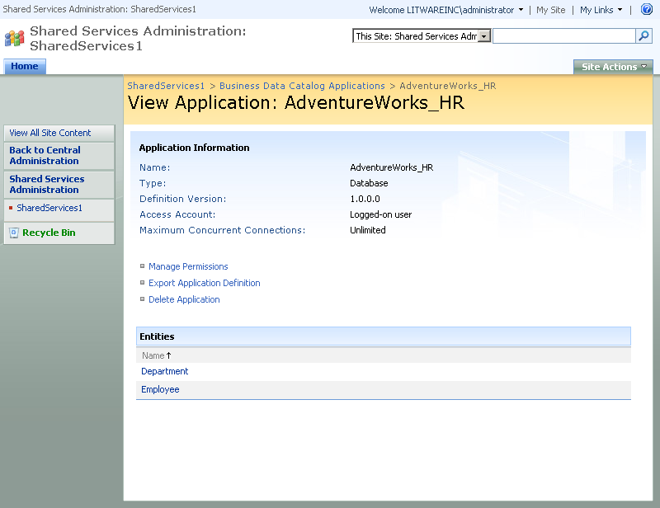
Administration of BDC Applications

Slide 9
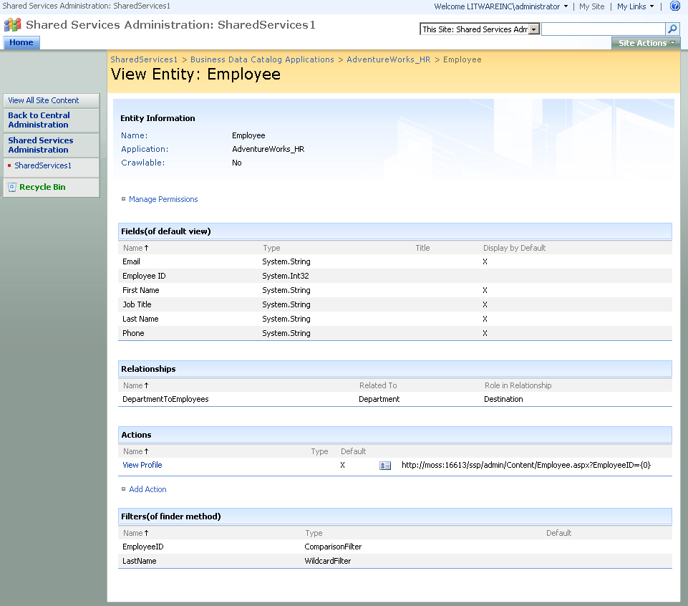
Examining BDC Application Entities

Slide 10
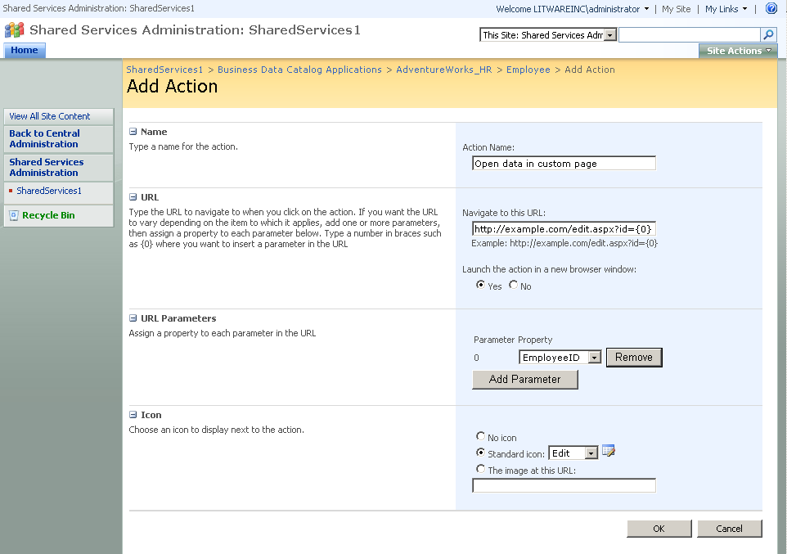
Adding Actions to an Entity

Slide 11
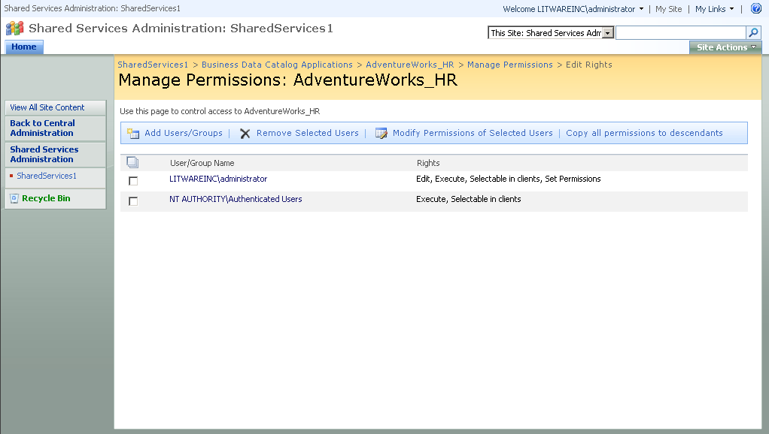
Administrating Security

Slide 12
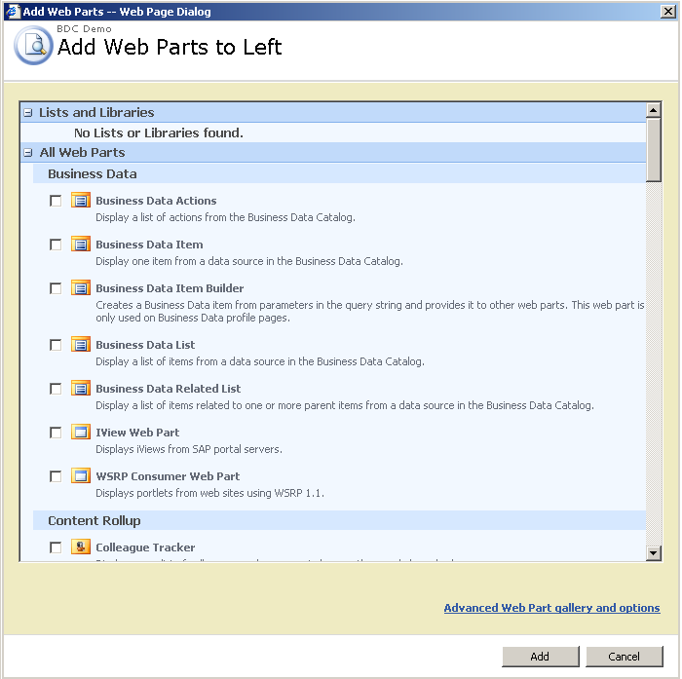
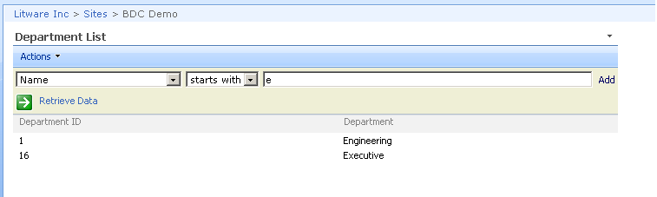
Using BDC Web Parts

Slide 13
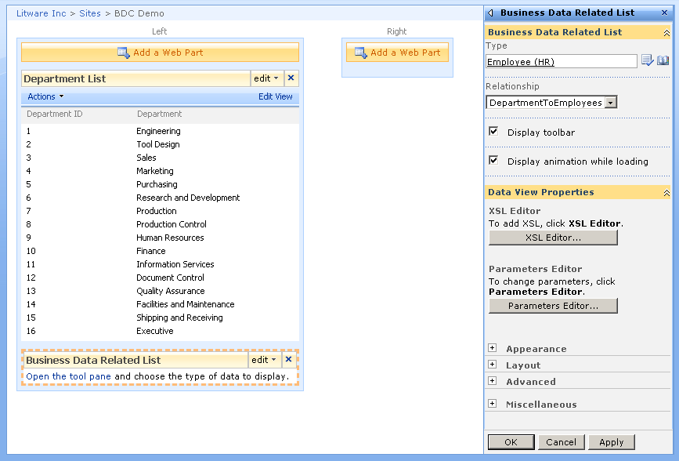
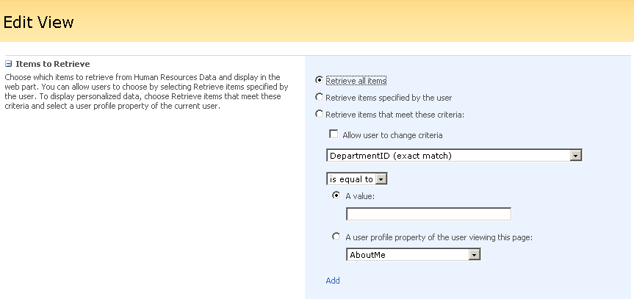
Editing BDC Web Parts

Slide 14
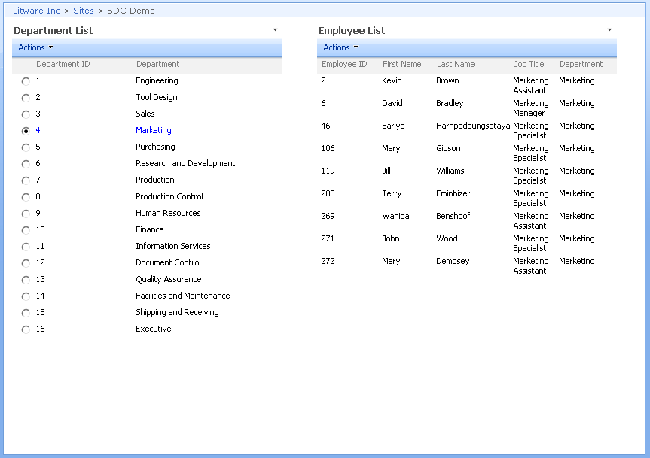
Connecting Web Parts with Associations

Slide 15
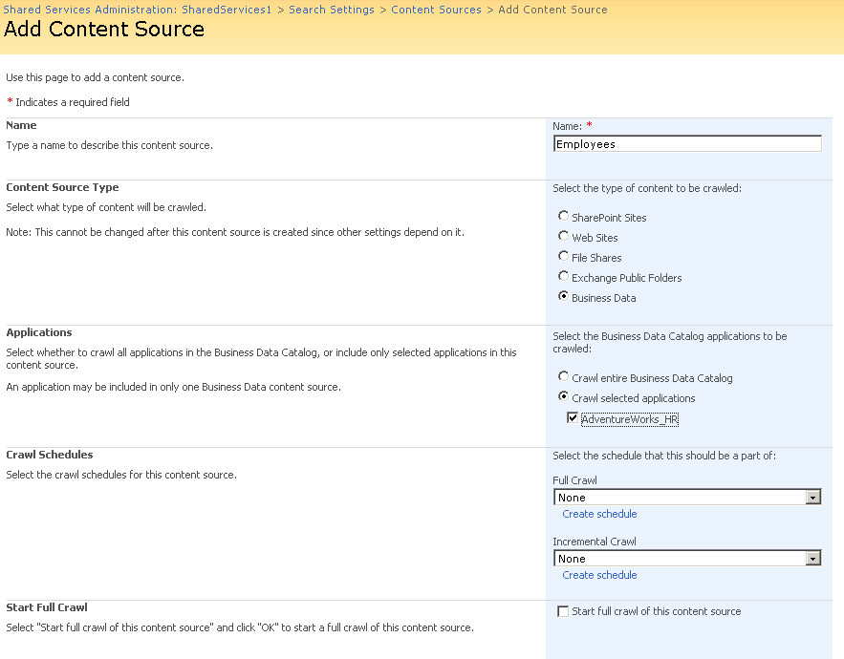
Searching through BDC Applications

Slide 16
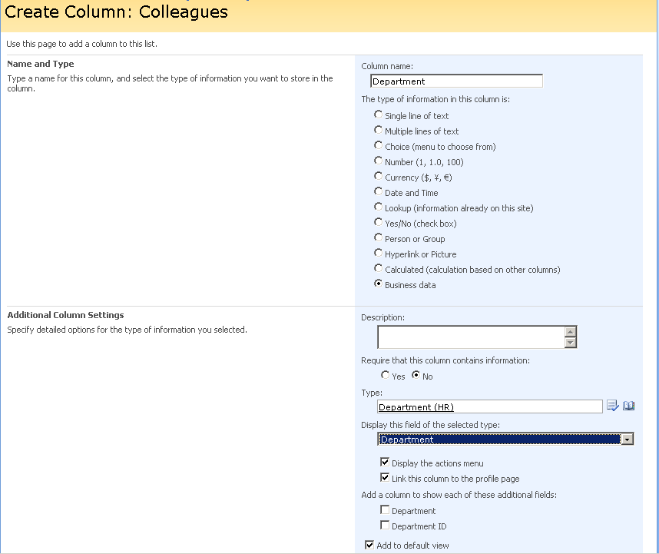
Adding BDC Columns to WSS Lists

Slide 17
Summary
Motivation for the BDC
Application Definition Files
Application, Entities, Methods and Associations
Using the built-in BDC Web Parts
BDC integration with MOSS search
Creating custom BDC Web Parts

